Slide 1
Significant Moments in the Summer Olympics By: Sena
Key concept#2
Visual-Spatial (Images and space)
KEEP CLICKING

Slide 2
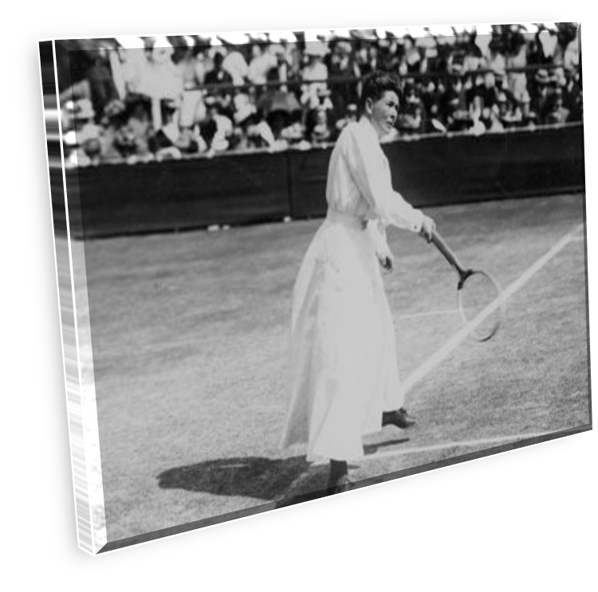
Paris 1900 Olympics
This picture shows one of the most significant moments in Olympic history. It is a significant moment because the women in this photo is one of the first few women who competed in the games. Although they were only allowed to play three sports during that time, golf , tennis, and croquet , it was the beginning of women’s participation in the Olympics.
-One of the first female athletes who played tennis in the Olympics.

Slide 3
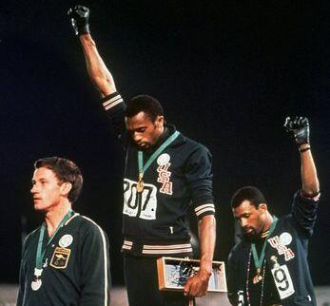
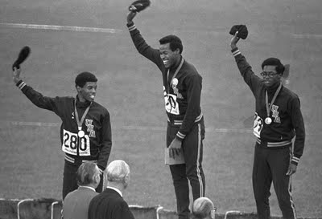
Olympic Protest, 1968 Olympics
The photo that is closest to this text, shows two men doing the Black Power Salute during the American anthem. The two men, Tommie Smith and John Carlos, were suspended and had their medals stripped away. The next day three athletes, Lee Evans, Larry James and Ron Freeman, wore black berets to show that they were against racism, this is on the second photo. These events were important because it showed a movement towards anti-racism.
-Tommie Smith and John Carlos doing the Black Power Salute.
-Lee Evans, Larry James and Ron Freeman waving their black berets.

Slide 4
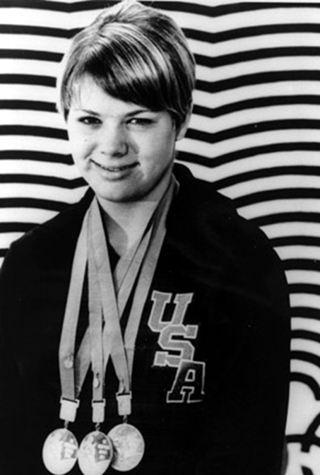
Debbie Meyer, 1968 Olympics
In the 1968 Olympics, Debbie Meyer was the first women to win three individual medals, the 200, 400,and 800 meter swim, at the same game. This was a significant moment because Debbie Meyer’s swimming accomplishment was an Olympic record.
-Debbie Meyer’s wearing her 3 Olympic gold medals around her neck.

Slide 5
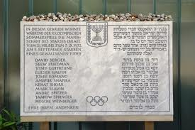
Terrorist Attack, 1972 Olympics
During the 1972 Olympics in Munich, Germany, there was a devastating terrorist attack. The reason why this is a significant moment in the Olympics is because this raised more security in the Olympics. In the terrorist attack , eight Palestinian terrorists took eleven hostages and threatened to kill them if the country didn’t release two hundred and thirty-four Israel prisoners. In the end, the eleven hostages, five terrorists and one policeman died.
-This is an memorial plaque, which has the names of the people who have died.

Slide 6
Greg Loganis, 1988 Olympics
During the 1988 Olympics, Greg Loganis competed in the diving section. Greg came to the Olympics that year to redeem his title of Olympics champion, but during the competition Greg hit his head while diving on the diving board. The reason why this is considered a significant event is because after he hit his head, Greg still continued on to his last dive in the Olympic event. In the end Greg won the gold medal in the Olympics for diving.
-Greg Loganis preparing to dive.

Slide 7
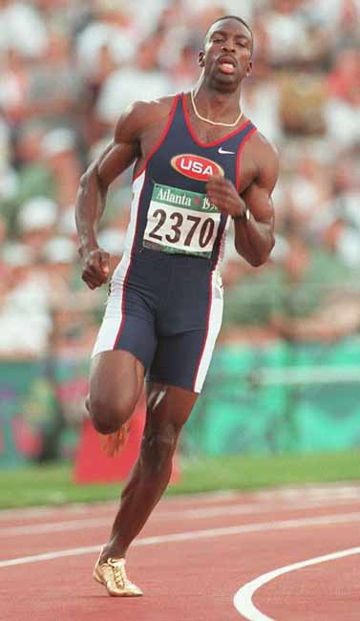
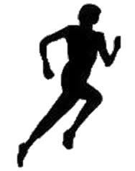
Michael Johnson, 1992 Olympics
Michael Johnson was the first athlete to win both the 200 meter and 400 meter gold at the same Olympics, but then many other athletes have repeated his achievement and the audience started to doubt his Champion title. To defend his title Michael Johnson came back to the Olympics in 1992 and made another first by winning two 400 meter gold medals. This is a significant event because Michael was the first person to win two 400 meter gold medals at one game and being the first to win both 200 meter and 400 meter at the same games.
-Michael Johnson running in the Olympics.

Slide 8
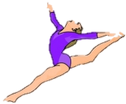
Kerri Strug, 1996 Olympics
This photo, which was taken in the 1996 Summer Olympics, shows Kerri Strug with a broken ankle after her first vault attempt. This is significant because the gymnast Kerri Strug surprisingly won gold despite her broken ankle. Since she had an injured ankle, Kerri could only land on one foot, but nevertheless made a perfect one-footed landing.
-Kerri Strug is being carried by her coach because she has broken her ankle

Slide 9
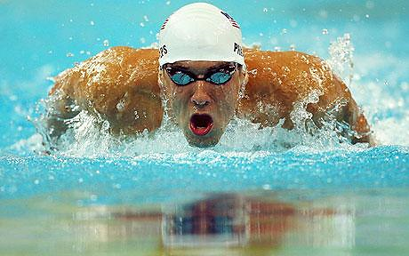
Michael Phelps,2008 Olympics
Michael Phelps is a 23 year-old athlete who competed at the 2008 Olympics in Beijing for swimming. At this Olympic event Michael won 8 out of 8 possible gold medals. This was a significant event because Michael's achievement as an Olympic record.
-Michael Phelps swimming in one of the 8 competitions.

Slide 10
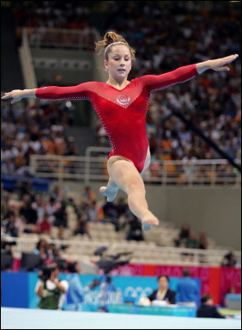
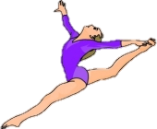
Carly Patterson, 2004 Olympics
In the year 2004, Carly Patterson was at Athens competing in the Olympics for gymnastic. Carly was the second women who had ever won a gold medal at the individual all-around. It is known as a significant event because she was one of the two people who had won the individual all-around. Carly also did this while she was battling several bulging discs throughout the competition.
-Carly Patterson doing her gymnastics routine at the Olympics

Slide 11
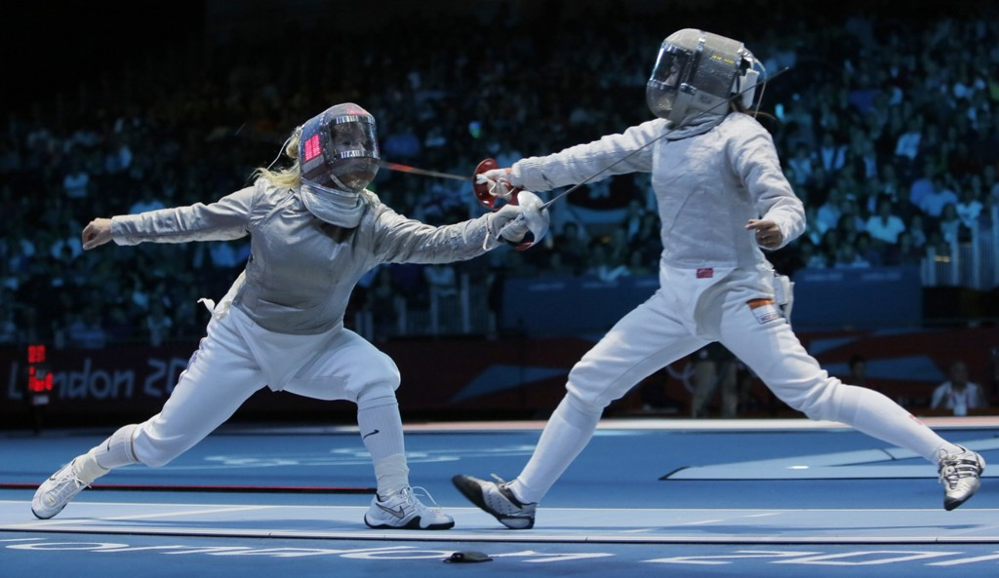
Mariel Zagunis, 2004 Olympics
Mariel Zagunis is an American fencer, who competed in the 2004 Olympics in Athens . She competed in the Women’s Saber fencing in the Olympics. This photo is significant because it shows American fencer Mariel Zagunis fencing against Chinese fencer Xue Tan . In this match Mariel wins 15-9 which makes her the first American to win gold in 100 years.
-Mariel Zagunis fencing against Chinese fencer Xue Tan.

Slide 12
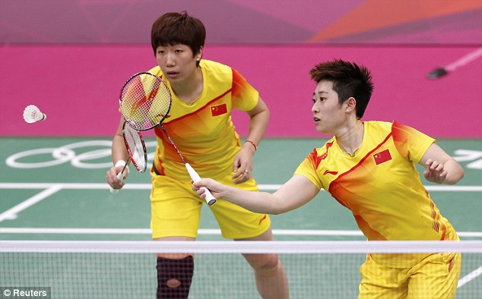
8 players disqualified in badminton, 2012 Olympics
In this photo, it shows one of the four female badminton teams who were disqualified from the Olympics. They were disqualified because they were trying to lose the match to go against an easier team, so they could beat the easier team and rank higher. Unfortunately, two teams , which both were trying to lose, had gone up against each other . When people found out that they were deliberately trying to lose they were disqualified. In result, 4 teams were disqualified, whom were one Chinese team, one Indonesian team, and two Korean teams. This was significant because nobody has tried as hard to lose deliberately to get to a higher rank.
-Two athletes from the Chinese team trying to lose

Slide 13
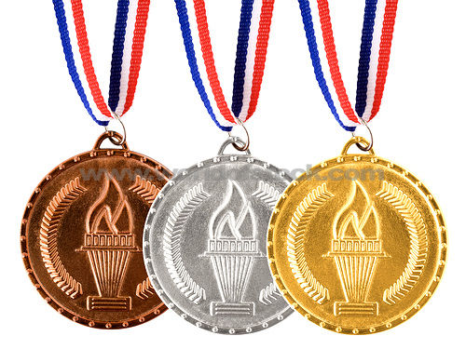
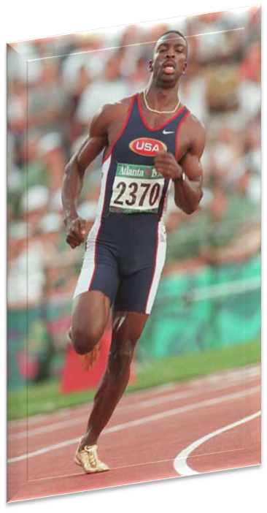
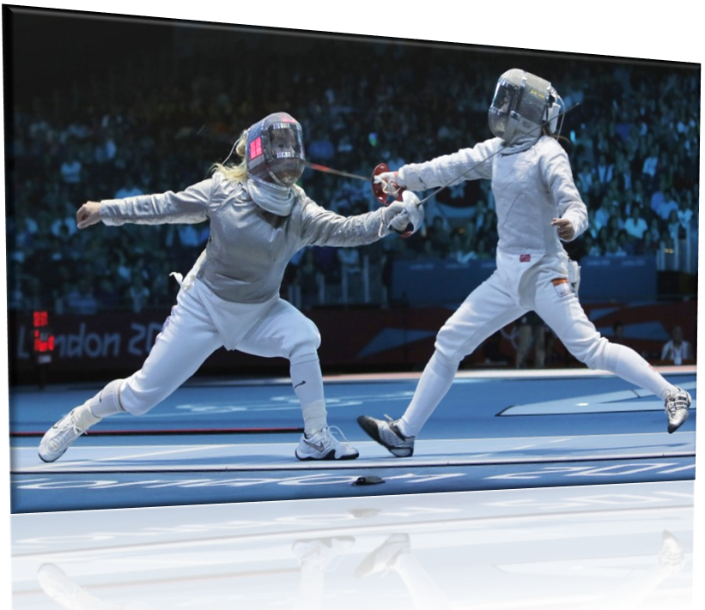
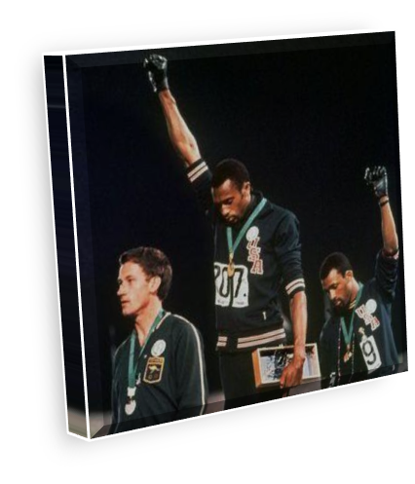
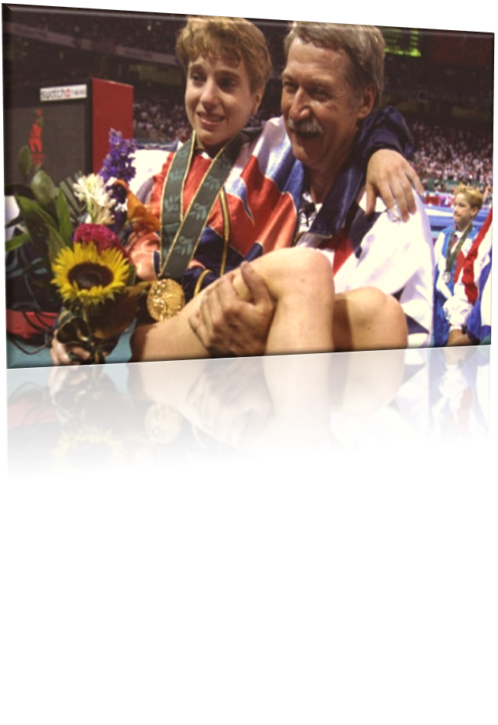
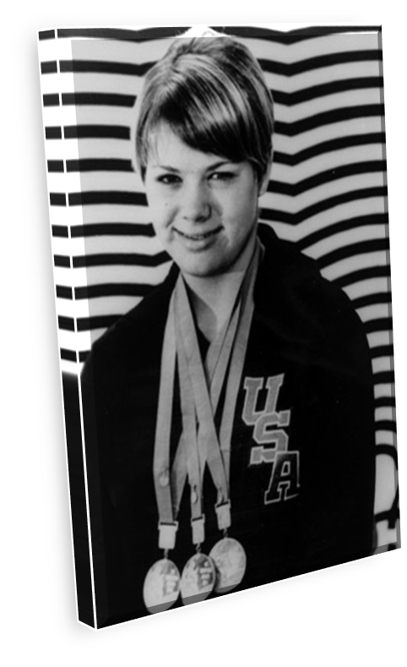
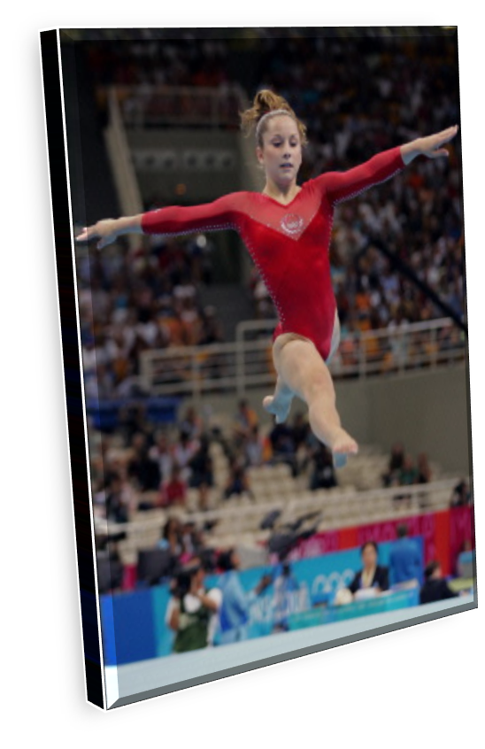
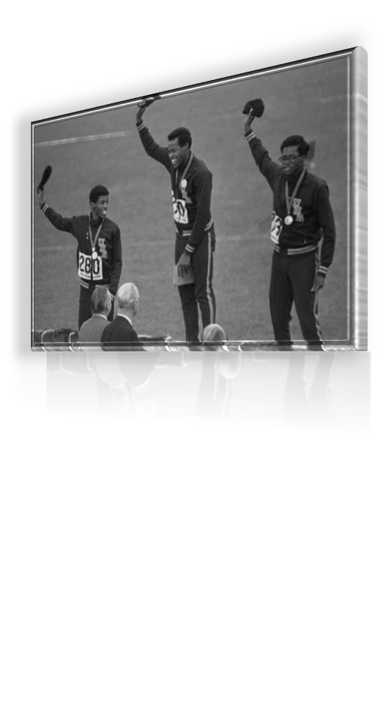
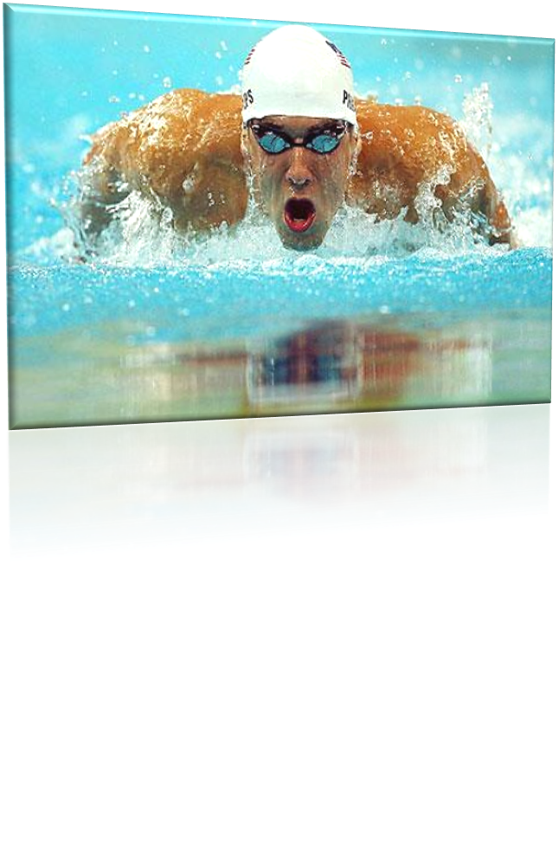
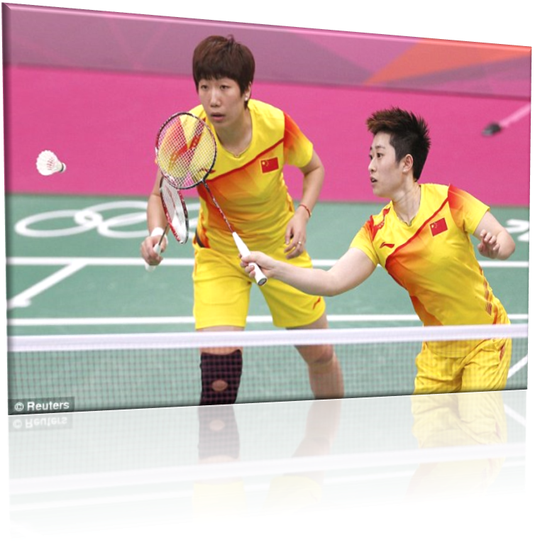
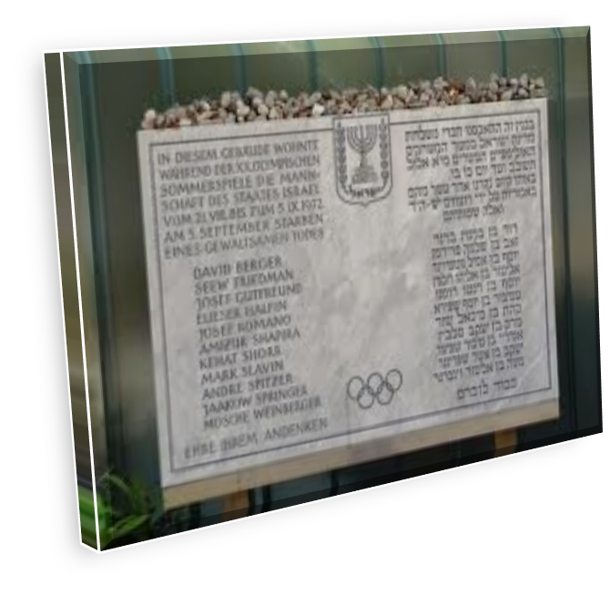
THE END

