Slide 1
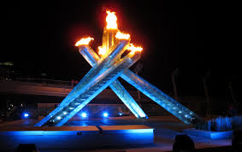
Olympic Project #1
#1: Olympic City Study
By: Tara K.

Slide 2
Introduction
In 2010, the city of Vancouver hosted the Olympic Winter Games. Athletes from all over the world and from many different winter sports came to compete for gold. I don’t remember a lot from 2010, but I know I was really excited. Sadly, though, I didn’t get to go to any events. But I’m pretty sure the sport I was most excited about was figure skating, so I made sure that I watched it on TV. In this slideshow, I’ll be discussing 5 significant moments/facts that occurred during the 2010 Vancouver Winter Olympics, as well as some important legacies that the Games left behind.

Slide 3
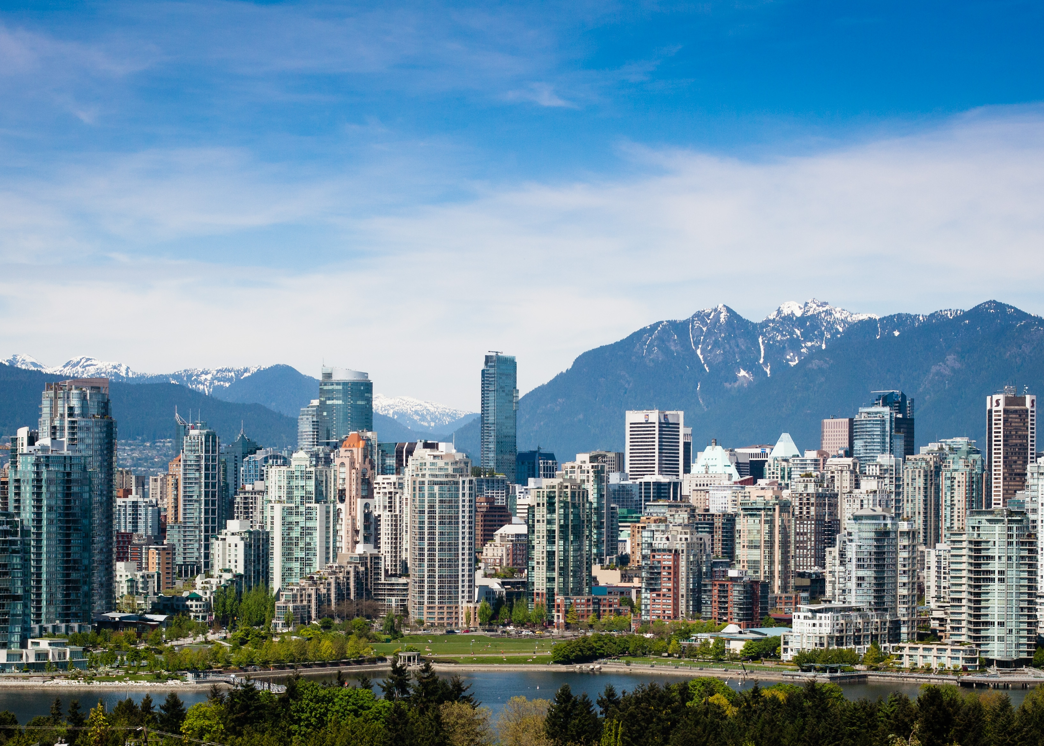
5 Significant Moments:

Slide 4
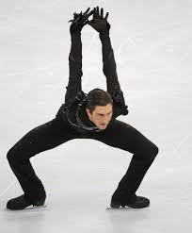
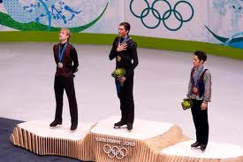
#1
The famous American figure skater Evan Lysacek took first place and outskated the living legend Evgeni Plushenko-who is a ten-time Russian National gold medalist, seven-time European Champion, three-time World Champion, 2006 Winter Olympic winner, and 2002 and 2010 silver medalist.
I think both skaters are extremely talented, but I like Evan Lysacek better, because he seems less arrogant than Evgeni, who is not known for his politeness. Unfortunately, Evan will not be competing at the Sochi Olympics, due to an injury. If he did compete this year, though, I’d be confident that he’s good enough to repeat his 2010 success, and he definitely deserves the medal more than Evgeni Plushenko does. But now that Evan Lysacek isn’t participating, I think that Evgeni Plushenko will end up with the gold.
To watch Evan’s long program: http://www.youtube.com/watch?v=KmJgGHIoawU
To watch Evgeni’s long program: http://www.youtube.com/watch?v=xtY1CuAbLgs

Slide 5
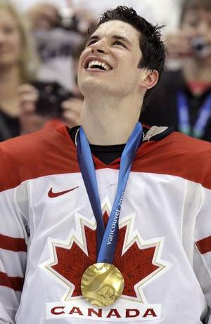
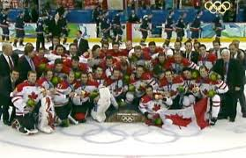
#2
The young Canadian hockey player-and Pittsburg Penguin of the NHL-Sidney Crosby scored the game-winning goal 7:40 into overtime to take the gold for his team and beat team USA-who happens to also be one of Canada’s biggest rivals. I myself am not a huge fan of Sidney Crosby in the NHL, but on team Canada, he is amazing! I don’t remember watching the game live, but watching the reruns never gets old! Team Canada, in my opinion (and probably lots others’) has some of the BEST players in the NHL, including Sidney Crosby, Jonathan Toews, Corey Perry, and Roberto Luongo. I’ve compared both USA’s and Canada’s 2010 team roster to 2014’s, and they have more or less stayed the same. Assuming the players are all in great shape and ready to play, if the same scenario happens, where it’s Canada vs. USA for the gold, my bets are on Canada, and not just because I’m Canadian.
Canada 2010 roster: http://www.nhl.com/ice/page.htm?id=60524
Canada 2014 roster: http://www.tsn.ca/canadian_hockey/feature/?id=1131
USA 2010 roster: http://www.nhl.com/ice/page.htm?id=60504
USA 2014 roster: http://www.tsn.ca/nhl/feature/?id=111316
Watch the recap of the Gold Medal Game: http://www.youtube.com/watch?v=G7DeQbTzPE8

Slide 6
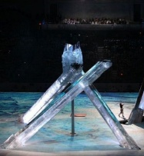
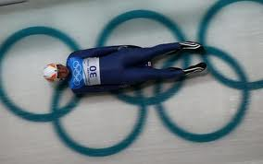
#3
I will never be able to fully imagine what it’s like to pursue your dreams, and finally reach your goal, then have your hopes shattered when you get into the accident that’ll claim your life, but that’s pretty much exactly what happened for the Georgian luger, Nodar Kumaritashvili. It must be devastating, mostly for your loved ones. And what’s sad is that Nodar Kumaritashvili’s death was not the first Olympic death, nor the first luger to have died, and probably not the last death, either. There has been at least 5 previous deaths leading up to the 2010 Games. This year, at the 2014 Sochi Games, I really hope that no athletes, of any sport, get severely injured, or die.
Despite all that, plus an Olympic Cauldron malfunction, and warm weather causing lack of snow, the Vancouver Games are still considered to be one of the best Winter Games yet.
Watch what happened to Nodar Kumaritashvili: http://www.youtube.com/watch?v=OSCancykuTY

Slide 7
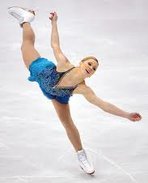
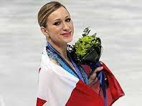
#4
One of Canada’s five bronze medals from 2010 was won by figure skater Joannie Rochette, whose mother died of a sudden heart attack just days before her success; her medal was also Canada’s first in that event since 1988!
I really admire Joannie Rochette. Not only is she an amazing figure skater, the 2010 Olympic Games really showed how emotionally strong she is. To have her mother die without warning, right before her skate, was no doubt really hard on her. Yet Joannie went and skated beautifully, and her hard work paid off with a well-earned bronze medal. She may not be as great a skater as Yuna Kim, or Mao Asada, but I think she’s stronger than them. Sadly, since she has not competed at a single major national or international event since her mother’s death, Joannie will not be competing at the 2014 Games in Sochi.
Watch Joannie Rochette: http://www.youtube.com/watch?v=Yzmpml4pUhg
Watch Yuna Kim (Gold): http://www.youtube.com/watch?v=0xeO1qWH1JA
Watch Mao Asada (Silver): http://www.youtube.com/watch?v=jrEZgoPpCAI

Slide 8
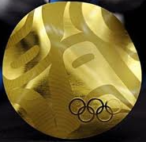
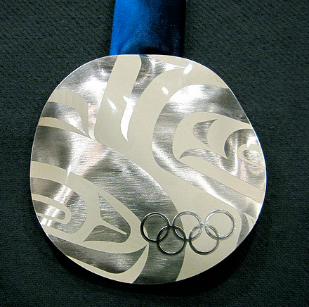
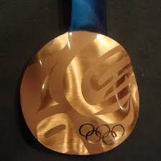
#5
The total number of medals that Canada won in the 2010 Winter Olympics is 26 (14 gold, 7 silver, 5 bronze), and is the highest number of medals this country has ever won in the history of the Winter Olympics! I wonder if it’s possible for Canada to win even more medals this year. It’s doable, for sure, I just hope that all the athletes competing are just as good, if not better, than they were in Vancouver (assuming they were in the Olympics last time). In the last Winter Games (2010), though Canada did finish with the most gold medals-which is 4 more gold than Germany ended with-we did not finish with the most medals. USA had a total of 37 medals, and Germany 30. This February, it would be great if we could not only end with even more medals than we did the last time, but also have the most gold medals, and have the most medals total!

Slide 9
Legacies That the Winter Olympics Left Behind:

Slide 10
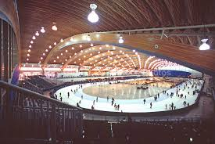
Sporting Legacy
The athletes in the 2010 Winter Olympics inspired many youths around Vancouver to get active, try out new sports, and live a healthy life! Since then, numerous recreational and high performance sports programs have been created for young people to have fun and exercise. Now, I’m quite active, so those new programs didn’t really affect me, but if I imagined that I wasn’t already active, and wanted to be, this would be a great opportunity to do so.
Also, new recreational centres were built for the athletes’ use. For example, the Richmond Oval- it includes a fitness centre, badminton and volleyball courts, an indoor track, and two ice rinks. I’m pretty sure I’ve never been to the Richmond Oval, but it sounds pretty amazing. I wonder if famous athletes ever train there; it certainly looks ‘good’ enough for them

Slide 11
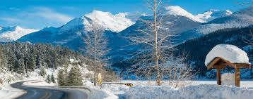
Transport/Infrastructure Legacy
The hosting of a world-wide event caused Vancouver to improve its transportation and infrastructure-a new Seabus, many skytrains, and over 100 hybrid buses were added into the city. I get that because of all the tourists and athletes in Vancouver they’d need to add in a bunch of things to make the city better and safer, but how would they have room to add all those buses? There’s only the same number of roads as before. I’d think that by adding things in, it partly makes it worse; it would add to all the traffic that’s already in the streets. The highway from Vancouver to Whistler was also made safer and quicker, as some of the Olympic events were being held on the mountain. Good thing, too, because I’m sure no one would want any athletes or tourists (anyone, really) to get in an accident involving a rockslide or something equally as dangerous. And the great thing about the renovated highway is that it’s permanent. Whenever I go up to Whistler, during the summer or winter, I usually feel a lot safer on the drive than I used to.

Slide 12
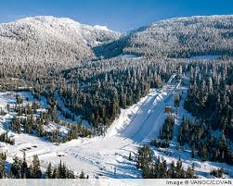
Whistler Olympic Park
The Olympic Park was built in Whistler, to stage the Paralympic Games, cross-country skiing, ski jumping, and many more events. On top of that, over one third of all the medals in the 2010 Winter Olympics were awarded here! I don’t remember if I’ve been there before, but I’d like to. I know that the Winter Olympics will probably not be hosted for a long time (or never) in Vancouver again, but if it is, I think it would be really cool if they used the same Olympic Park at Whistler. It would probably save a lot of money. Also, if they did host it again, they might not need to add as many buses into the city, and renovate the highway, since it was already fixed the last time. Then again, the Olympics wouldn’t be hosted here for a really long time, so maybe they would need to redo everything, simply because it’s been too long. I wish the Olympics were in Vancouver again; I’d really enjoy going to one of the events, preferably figure skating.

Slide 13
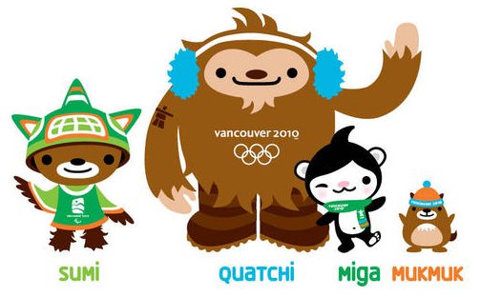
Thank-you For Your Time!
Thanks for watching! Hopefully the same things-or some of-I found interesting were also interesting for you!

Slide 14
Bibliography
For the 5 moments:
http://www.olympic.org/vancouver-2010-winter-olympics
http://www.vancitybuzz.com/2013/02/three-years-later-a-reflection-on-the-vancouver-2010-olympic-games/
http://olympic.ca/games/2010-vancouver/
http://bleacherreport.com/articles/1913267-team-by-team-guide-to-which-nhl-players-are-going-to-the-2014-winter-olympics
http://keepingscore.blogs.time.com/2010/03/01/top-10-memorable-moments-of-2010-winter-olympics/slide/joannie-rochettes-grace-under-pressure/
http://www.csmonitor.com/World/Olympics/Olympics-blog/2010/0301/Top-12-inspiring-moments-we-saw-at-the-Vancouver-Olympics
http://www.cbsnews.com/news/athlete-deaths-rare-during-olympics/
http://olympictalk.nbcsports.com/2013/09/16/joannie-rochette-figure-skating-canada-sochi-cbc/
For the legacies:
http://www.olympic.org/news/vancouver-2010-legacy-lives-on/167164
http://www.olympic.org/news/vancouver-2010-the-games-are-over-but-the-legacy-lives-on/118676
http://www.olympic.org/Documents/Games_Vancouver_2010/Factsheet_Vancouver_legacy_February_2011_eng.pdf
http://www.whistlerolympicpark.com/about/fact-figures
Pictures:
http://worldbookonline.com/advanced/media?id=pc005508&st=olympic+rings
http://www.google.com/imghp

