Slide 1
Significant moments in OLYMPIC GYMNASTICS
By : Olivia L.

Slide 2
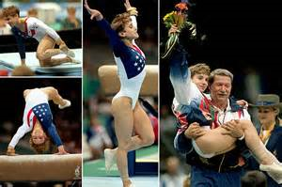
Kerri Strug
I chose this photo because Kerri Strug competed with an injured ankle to win the U.S.A. team gold and this demonstrated great Olympic spirit.

Slide 3
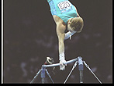
Vitaly Scherbo
I chose to use this photo because Vitaly was a great gymnast who won 6/8 available gold medals in the ’92 Olympics and then went on to win 23 world championship medals.

Slide 4
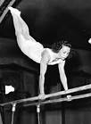
Clara Schroth
I used this photo because Clara was the first female American gymnast to win a medal in the Olympic games.

Slide 5
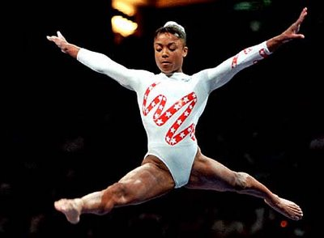
Dominique Dawes
I chose this photo because Dominique was the first African - American gymnast to medal in the Olympics and this was a significant moment in Olympic history.

Slide 6
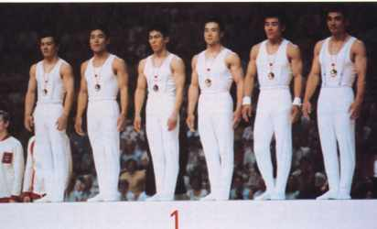
Shun Fujimoto
I included this photo because Shun competed on the rings with a broken knee and won Japan their 5th team gold in a row.

Slide 7
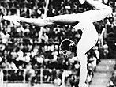
Olga Korbut
I put in this photo because Olga competed in 2 different Olympic games for the U.S.S.R. and won a total of 6 medals, she become a popular gymnast right after the Olympics.

Slide 8
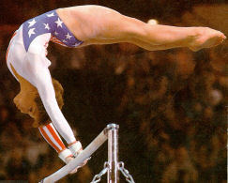
Mary Lou Retton
I included this photo because Mary Lou competed for the U.S.A. in the 1984 Olympics and won a total of 5 medals.

Slide 9
Ludmilla Tourischeva
I decided to use this photo because Ludmilla competed in three different Olympic games and won the U.S.S.R. a total of 8 medals.

Slide 10
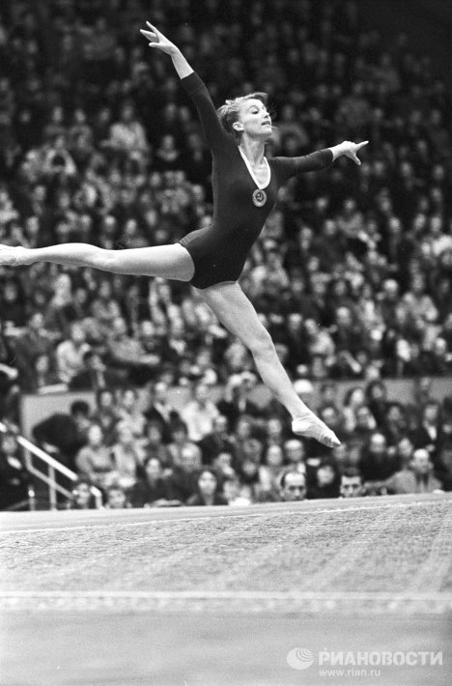
Polina Astakhova
I used this photo because Polina won a total of 9 medals for Ukraine in 3 different Olympic games and normally olympic gymnasts compete in one games and maybe two.

Slide 11
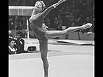
Larisa Latynina
I chose to use this photo because Larisa set a world record for the most Olympic medals won in any sport male or female (in multiple games). She won 18 medals for the U.S.S.R., her record stood for 48 years.

