Slide 1
Welcome to More than a Cluster… please join http://todaysmeet.com/nagc708 for backchannel discussion during this presentation

Slide 2
More Than A Gifted Cluster: A Districts Approach to Gifted Education in the Middle Years
Christine Abbot
cabbot@sd43.bc.ca

Slide 3
Research
“…usual remedy is to segregate these students into small homogeneous groups or to assign individual projects” (Parke, 1989)
“Differentiated instructional opportunities allow gifted students to interact with their intellectual as well as their age peers. Through cluster grouping the intellectual, social, and emotional needs of the gifted students can be addressed.” (Schular, 1997)
“…in a mixed ability classroom gifted learners differ from their class mates on three key dimensions: the pace at which they learn; the depth of their understanding; the interests that they hold” (Maker, 1982)
“Compared to within-class clusters … to gifted students receiving no services at all, the students in the special schools, homogenous classes, and pull-out programs showed substantially higher levels of achievement.” (Delcourt et al, 1994)

Slide 4
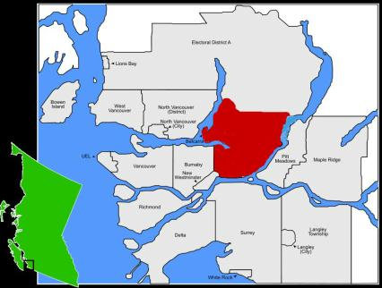
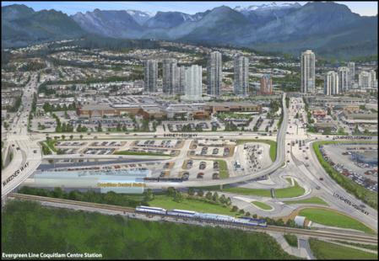
Context
Notes:
Coquitlam School District:
represents 3 cities and 2 villages in suburban Vancouver
13 middle schools
Enrolment is over 30,000 (3rd largest district in BC)
565 identified gifted learners
Average middle school class size:28

Slide 5
Process
Proposal to Board of Education by Task Group for a rigorous academic program that requires students to work toward building skills for autonomous, life long learning
Cluster gifted learners in classrooms at 3 locations in the school district where students are in homogeneous groups for Math, Science, English, Social Studies, Health, French and in heterogeneous groups for PE, exploratory/ elective classes

Slide 6
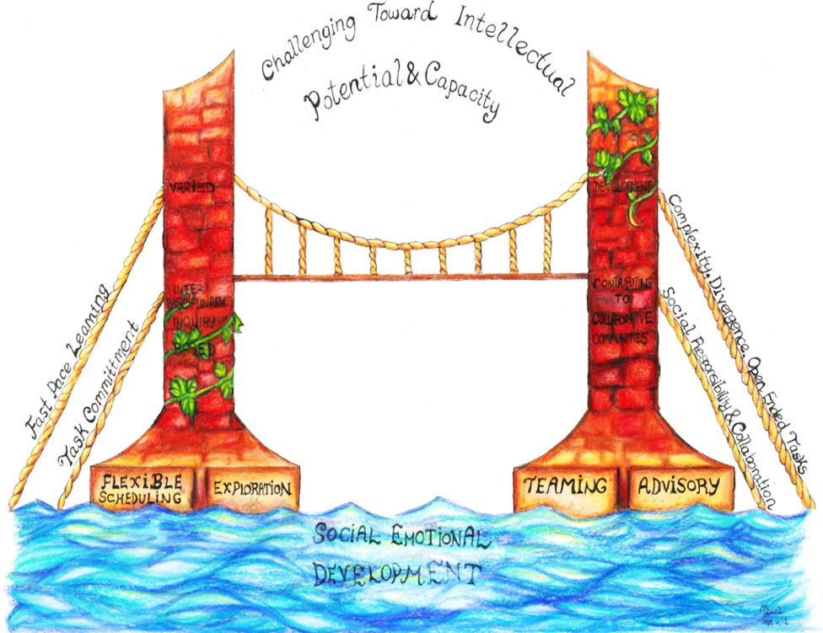

Slide 7
Pre-Assessment & Formative Assessment
Choice
Flexible groupings
Learning Contracts
Tiered Assignments & Projects
Homogeneous Groups
Acceleration
Inquiry & Inter-disciplinary
Model

Slide 8
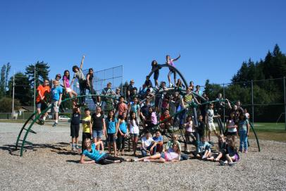
Activity
Notes:
Brainstorm any questions you have personally, or about community, or globally.

Slide 9
Questions
1
2
Community
3
Global
Personal
Notes:
Share some of your questions with someone else in the room.

Slide 10
Walk About and Discuss
0
0
5
4
3
2
1
0
0
9
8
7
6
5
4
3
2
1
0
9
8
7
6
5
4
3
2
1
0
9
8
7
6
5
4
3
2
1
0
9
8
7
6
5
4
3
2
1
0
9
8
7
6
5
4
3
2
1
0
9
8
7
6
5
4
3
2
1
0
0
4
0
3
Hours
Minutes
Seconds

Slide 11
Walk About and Discuss
0
0
5
4
3
2
1
0
0
9
8
7
6
5
4
3
2
1
0
9
8
7
6
5
4
3
2
1
0
9
8
7
6
5
4
3
2
1
0
9
8
7
6
5
4
3
2
1
0
9
8
7
6
5
4
3
2
1
0
9
8
7
6
5
4
3
2
1
0
0
3
0
2
Hours
Minutes
Seconds

Slide 12
Walk About and Discuss
0
0
5
4
3
2
1
0
0
9
8
7
6
5
4
3
2
1
0
9
8
7
6
5
4
3
2
1
0
9
8
7
6
5
4
3
2
1
0
9
8
7
6
5
4
3
2
1
0
9
8
7
6
5
4
3
2
1
0
9
8
7
6
5
4
3
2
1
0
0
2
0
1
Hours
Minutes
Seconds

Slide 13
Walk About and Discuss
0
0
5
4
3
2
1
0
0
9
8
7
6
5
4
3
2
1
0
9
8
7
6
5
4
3
2
1
0
9
8
7
6
5
4
3
2
1
0
9
8
7
6
5
4
3
2
1
0
9
8
7
6
5
4
3
2
1
0
9
8
7
6
5
4
3
2
1
0
0
1
0
0
Hours
Minutes
Seconds
Notes:
What did you notice about the questions? Any commonalities?

Slide 14
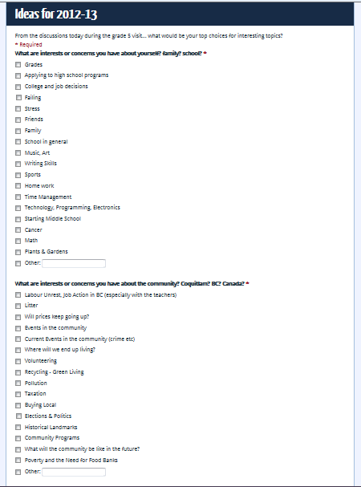
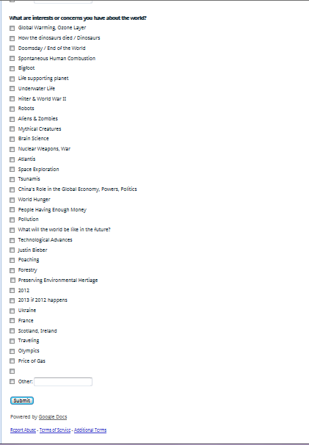
Student Brainstormed Topics

Slide 15
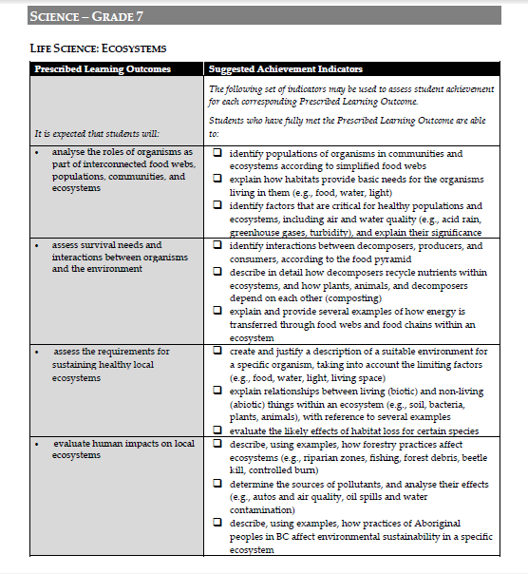
Learning Objectives

Slide 16
The Synthesis

Slide 17
The 5 C’s
Choice Challenge
Complexity
Control Caring

Slide 18
New Work
The technology learning curve
Notes:
Add slides to each topic section as necessary, including slides with tables, graphs, and images.
See next section for sample table, graph, image, and video layouts.

Slide 19
Questions?

